Slide 2
1st Place – Sponsor Program
1st Place – Website
3rd Place - Brochure

Slide 3
3rd Place – Outdoor Advertisement

Slide 4
2nd Place – Radio
3rd Place – Outdoor Advertisement

Slide 5
1st Place – PR / Media Campaign
1st Place – Promotional Item

Slide 6
2nd Place – Website

Slide 7
1st Place – Annual Report

Slide 8
1st Place – Promotional Poster

Slide 9
1st Place – Promotional Poster

Slide 10
3rd Place – Television

Slide 11
3rd Place – Brochure

Slide 12
1st Place – Photo

Slide 13
1st Place – Radio
3rd Place – Promotional Poster
3rd Place – T-Shirt

Slide 14
3rd Place – Outdoor Advertisement
3rd Place - Tickets & Invitations

Slide 15
2nd Place – PR / Media Campaign
3rd Place - Website

Slide 16
1st Place - Tickets & Invitations
1st Place – Program / Event Guide

Slide 17
1st Place – Commemorative Poster

Slide 18
2nd Place – Website
2nd Place – Television

Slide 19
1st Place – Social Media
1st Place – Mobile App

Slide 20
1st Place – Community Outreach Program

Slide 21
2nd Place – Brochure

Slide 22
2nd Place – Brochure

Slide 23
2nd Place – Promotional Poster

Slide 24
1st Place – T-Shirt
1st Place – Commemorative Poster

Slide 25
1st Place – Outdoor Advertisement
2nd Place – Photo
3rd Place – Promotional Item

Slide 26
3rd Place – Television

Slide 27
3rd Place – Program/Event Guide

Slide 28
2nd Place – T-Shirt
2nd Place – Outdoor Advertisement
2nd Place – Commemorative Poster

Slide 29
1st Place – Social Media
1st Place – Television

Slide 30
1st Place – Educational Program

Slide 31
1st Place – Brochure

Slide 32
3rd Place – Website

Slide 33
1st Place – Program/Event Guide

Slide 34
3rd Place – Social Media
1st Place – Brochure

Slide 35
1st Place – Website
3rd Place – Television

Slide 36
2nd Place – Program/Event Guide
1st Place – Educational Program

Slide 37
3rd Place – Photo

Slide 38
1st Place – Photo
2nd Place – Social Media
2nd Place – Outdoor Advertisement

Slide 39
1st Place – Photo
3rd Place – Commemorative Poster

Slide 40
2nd Place – Mobile App

Slide 41
1st Place – Outdoor Advertisement
2nd Place – Educational Program
3rd Place – Promotional Item

Slide 42
2nd Place – Radio
2nd Place – Educational Program

Slide 43
1st Place – Television
1st Place – Program/Event Guide

Slide 44
1st Place – Social Media

Slide 45
2nd Place – Promotional Item

Slide 46
1st Place – PR / Media Campaign

Slide 47
2nd Place – Social Media

Slide 48
2nd Place – Television
3rd Place – T-Shirt

Slide 49
1st Place – Commemorative Poster
2nd Place – Promotional Poster

Slide 50
2nd Place – Website
3rd Place – Radio

Slide 51
1st Place – Volunteer Program
1st Place - PR / Media Campaign

Slide 52
2nd Place – Promotional Item

Slide 53
2nd Place – Community Outreach Program
3rd Place – PR / Media Campaign

Slide 54
Palm Beach County Day
1st Place – Community Outreach Program

Slide 55
1st Place – Promotional Poster
2nd Place – Promotional Item

Slide 56
1st Place – Radio
2nd Place – Program/Event Guide
3rd Place – T-Shirt

Slide 57
3rd Place – Community Outreach Program

Slide 58
2nd Place – Photo
3rd Place – Promotional Item

Slide 59
3rd Place – Social Media

Slide 60
2nd Place – T-Shirt
1st Place – T-Shirt

Slide 61
3rd Place – Tickets & Invitations

Slide 62
2nd Place – Photo
2nd Place – Radio
2nd Place – Social Media

Slide 63
1st Place – T-Shirt
1st Place – Annual Report

Slide 64
2nd Place – T-Shirt
3rd Place – Brochure
3rd Place – Program / Event Guide

Slide 65
3rd Place – Radio

Slide 66
1st Place – Television
1st Place – Website

Slide 67
3rd Place – Photo
3rd Place – Promotional Poster

Slide 68
2nd Place – Outdoor Advertisement
3rd Place – Promotional Poster

Slide 69
1st Place – Mobile App
2nd Place – Brochure

Slide 70
1st Place – Volunteer Program
1st Place – Green Program
3rd Place – Website

Slide 71
2nd Place – Tickets & Invitations
2nd Place – Promotional Poster
2nd Place – PR / Media Campaign

Slide 72
1st Place – Promotional Item
1st Place – Tickets & Invitations

Slide 73
1st Place – Brochure

Slide 74
3rd Place – Educational Program
3rd Place – Photo

Slide 75
1st Place – Outdoor Advertisement
2nd Place – Television

Slide 76
3rd Place – Social Media

Slide 77
2nd Place – Mobile App
2nd Place – Tickets & Invitations

Slide 78
1st Place – Promotional Item
1st Place – Radio

Slide 82
Most Innovative Project

Slide 83
Vendor / Supplier
of the Year

Slide 84
Emerging Leader

Slide 86
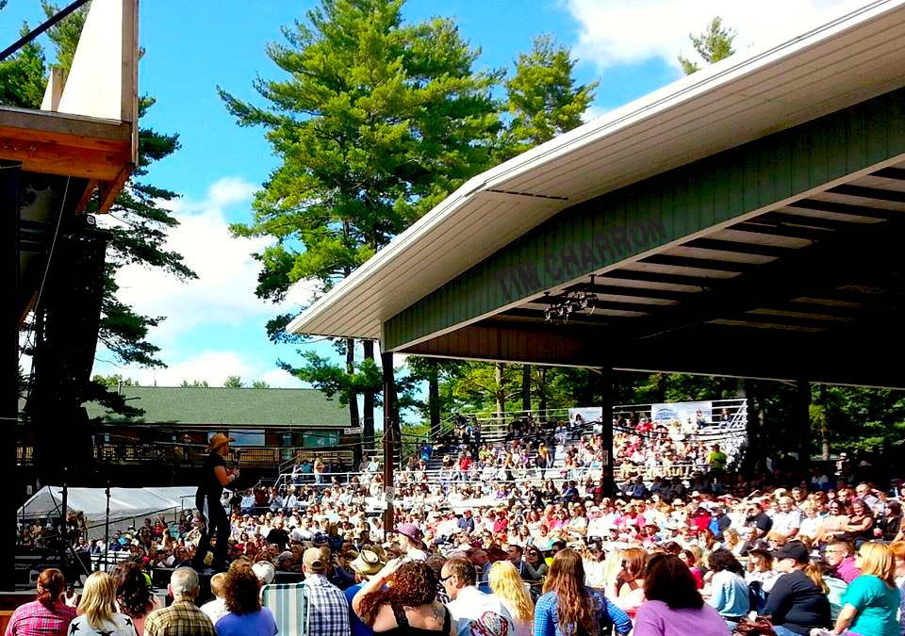

Slide 87
